Slide 1
Introduction
The goals of this training are;
Introduce new analysts to the common terms used in cat modelling results
How to interpret and communicate these results both internally and externally
Show some trends that tend to occur in modelled losses depending on region
Understand how this data is used to determine how much reinsurance to buy

Slide 2
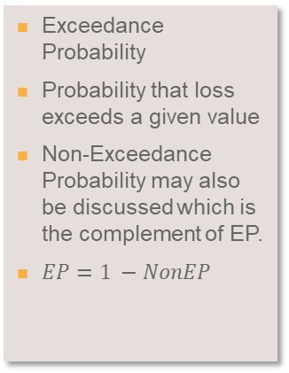
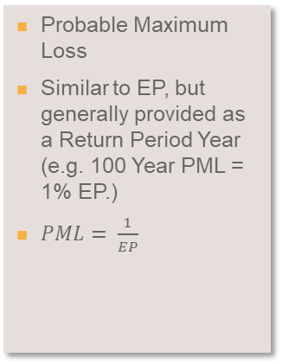
Common Terms
These terms will become very familiar…….
Expected Loss/AAL
STDEV
EP
PML
OEP/AEP
Average Annual Loss
This is interpreted as the amount of a loss a company can expect each year
RMS=sum of PERSPVALUE*Rate
AIR=sum of Loss / # of Years in Simulation (Typically 10K)
Standard Deviation of Loss
RMS generates correlated and independent standard deviations for every event to calculate loss
Exceedance Probability
Probability that loss exceeds a given value
Non-Exceedance Probability may also be discussed which is the complement of EP.
$EP=1 −NonEP$
Probable Maximum Loss
Similar to EP, but generally provided as a Return Period Year (e.g. 100 Year PML = 1% EP.)
$PML= \frac{1}{EP}$
Occurrence/Aggregate Exceedance Probability
OEP is the probability that the largest event in any given year exceeds some amount
AEP is the probability that the total of all events in a year exceeds some amount

Slide 3
Common Terms Continued
These terms will become very familiar…….
TVAR
ELT
YELT/Loss File
(Often referred to as a YLT)
YLT
EP Summary
Tail Value At Risk
This value represents the maximum loss that can be expected if a given loss occurs
Example – If a loss of at least $XXX occurs, then we could expect losses to be $XXX
Event Loss Table
Modeled output from RMS is an ELT
Contains all relevant loss information (Expected Loss, StdDev, Max Loss)
ELTs do not contain a Year so to simplify post model computations, we simulate Years and Events in TigerEye to be used in analyses
Year Event Loss Table
Modeled output from AIR is a YELT
Contains Loss information by event for each year
Can be loaded directly in to TigerEye, which is why it is often referred to as a Loss File internally.
Year Loss Table
Not usually used or seen but will commonly be used in place of YELT
Contains totals loss information by year
A report that summarizes return time losses along with AAL and Standard Deviation.
Can be generated for a Portfolio, Line of Business, Region or even Policy.

Slide 4
Sample EP Summary
01.
EP Summary
AAL and Standard Deviation
Return Time/ Exceedance Probability

Slide 5
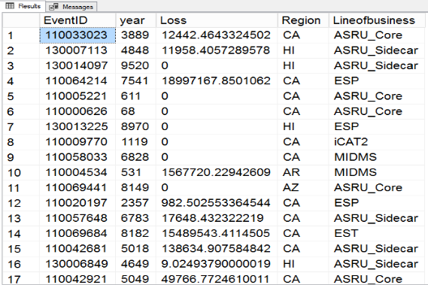
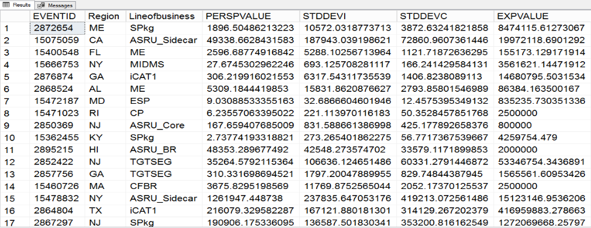
Sample ELT/YLT
01.
AIR (YLT)
Each event is assigned a year
Largest individual event in a year is the OEP
Losses summed up by year is the AEP
AAL can be calculated by dividing the total loss by the number of years in the analysis (typically 10K)
RMS (ELT)
Every event has a calculated loss (PERSPVALUE) and exposure (EXPVALUE) along with correlated and independent standard deviations (STDDEVC/STDDEVI)
To calculate AAL you need the event rate which is then multiplied against the loss value
There are no assigned years, we use TigerEye to simulate this ELT over 100K years in order to get output like AIR

Slide 6
Trends in Hurricane Losses
02.
Depending on the region that a client writes in the EP summary can look very different
Losses in Florida, the Gulf and Texas tend to be characterized by losses that are High Frequency/Low Severity
This does not mean that there are not large losses in the model for these regions, it just means that most events fall into the lower return periods because they are considered more common
Losses in the Mid-Atlantic and Northeast regions are the opposite, characterized by Low Frequency/High Severity Events
Losses tend to be negligible in the lower return periods but reach very high values at the higher return times
Hawaii is an active region but is a separate model and is not correlated with the rest of the US

Slide 7
Trends in Hurricane Losses
02.
Florida
General “smoothness” to the loss curve that indicates there are events in nearly every year of the models catalog
This happens because events in Florida are much more common and with that comes the expectation that large losses will occur more often
New York
Losses are larger at the top of the curve, coming in almost 2X Florida, but they quickly drop off by compared to what we see in Florida
Hurricanes in New York are much less common, and this is reflected in the model catalog but due to the large concentration of risk, extreme events cause significantly higher losses for these tail events

Slide 8
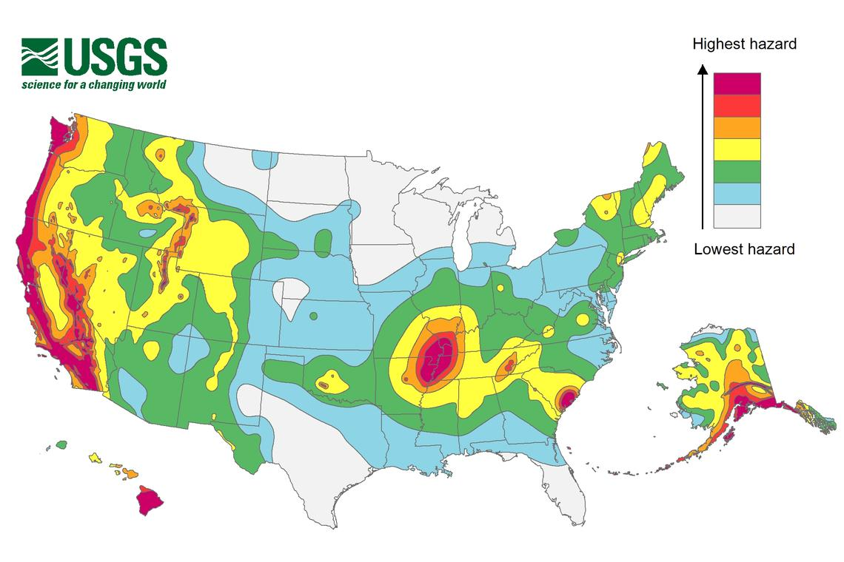
Trends in Earthquake Losses
02.
Unlike Hurricane, most earthquake events would be considered low frequency, high severity
Because earthquakes are relatively rare to begin with, most events can be significant there are just less of them in the model
The main EQ regions are California, the Pacific Northwest (Washington and Oregon) and New Madrid (IL,IN,MO,AR,TN) regions
Great Basin (NV,UT), South Carolina, Alaska and Hawaii are also active regions, but typically do not have a large impact when other regions are involved
Note that there are events that affect the entire US, but most are considered background seismicity events that are a kind of filler to account for the fact that things can happen there

Slide 9
Trends in Earthquake Losses
02.
California
Similar to Florida hurricane, there is a general smoothness to the curve, with losses following a stable trend towards the lower return times
AAL is typically largest in California unless there is little exposure
Note that adding Fire Following (a secondary peril) to your modelling will have the greatest impact in California as it generates most of the modeled loss for the peril
Washington
Losses at the tail end of the curve are large, but do not reach the same magnitude as California
Due to the lower number of events, there is a quick drop off to no expected loss
Fun Fact – We are “due” for a Cascadia earthquake, with scientists currently estimating there is a 37% chance of an event happening in the next 50 years

Slide 10
How do we use this to place reinsurance?
03.
Using a combination of things like exposure reports, actuarial loss analysis, cat modelling and financial information we work with clients to determine how much reinsurance is needed
Cat Models are especially helpful when it comes to informing a clients view of risk
Depending on the goals of the client (Premium Growth, Cat Protection, Additional Capacity, Balance Sheet Stability) the answer may be slightly different.
A company that is mostly concerned with their status in a difficult state like Florida is likely going to look for cat reinsurance protection to a certain return time to satisfy rating requirements
A company looking to grow quickly or into a new market may pursue per risk or quota share reinsurance to facilitate their growth while they try to reach their goals
There is not a one size fits all approach to this and the type of data that is used will vary by client

Slide 11
Questions?

